Slide 1

Wikipedia Popularity
Group 6:
Lilian Abdolahian
Edward Eisen
Narbeh Movsessian
Chris Tufenkjian

Slide 2
Outline
Background
The Data
Results
Further Research

Slide 3
Background
Goal
Analyze Page Popularity, Page Size, in and out links.
Find the correlations
http://en.wikipedia.org/wiki/2002_Pacific_typhoon_season

Slide 4
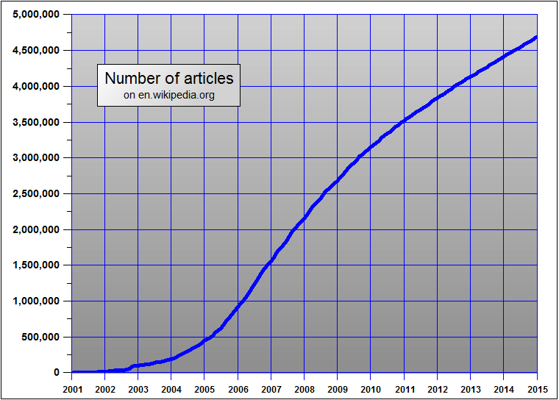
Background
Wikipedia:
Grows about 250,000 pages/year
As Trends Change, so do popularity of Wiki-pages
Project will only look at past statistics

Slide 5
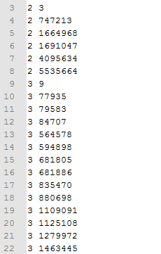
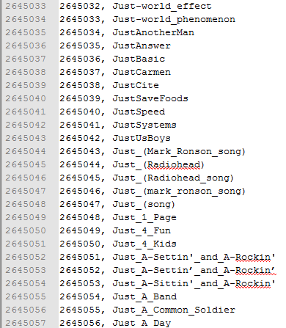
Data
Page Links File: List of Links between pages
Size: 167 GB
Page Index File: Links Page index to name
Size: 157 MB
Page hits Files: # of hits / page / hour and page size. One File per hour of 2010 (about 8760 files total)
Size: 152 GB per month
1.9 TB total (just page hits)

Slide 6
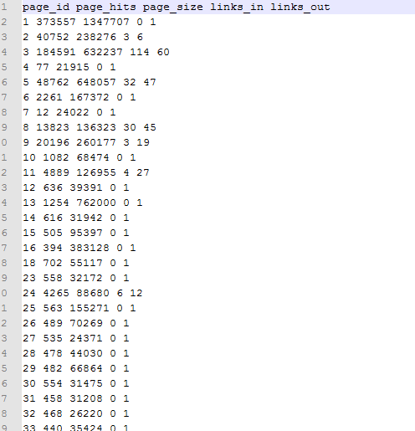
Data Refining
First step was to reduce data:
Map: {PageID, [YearsHits, Size, LinksIn, LinksOut]}
Reduce: YearsHits = sum(hits/month)
Size = largest size recorded
LinksIn = # of times in
PageLinks.ToPage
LinksOut = # of times in
PageLinks.FromPage
Multistep process

Slide 7
Data Refining
Final Size of Data (from 1.9 TB):
Links File: 1.9 GB
Page Info File: 117 MB
Index File: 154 MB

Slide 8
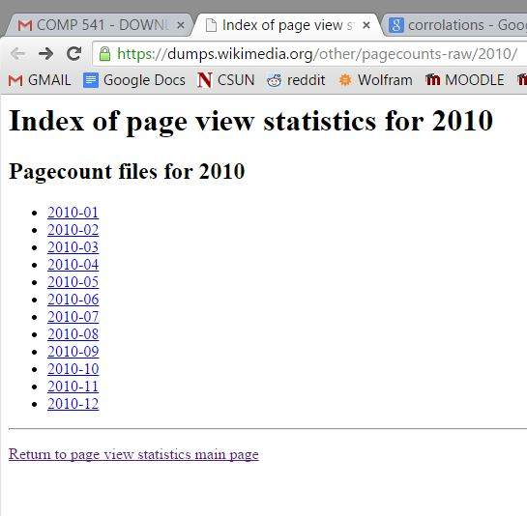
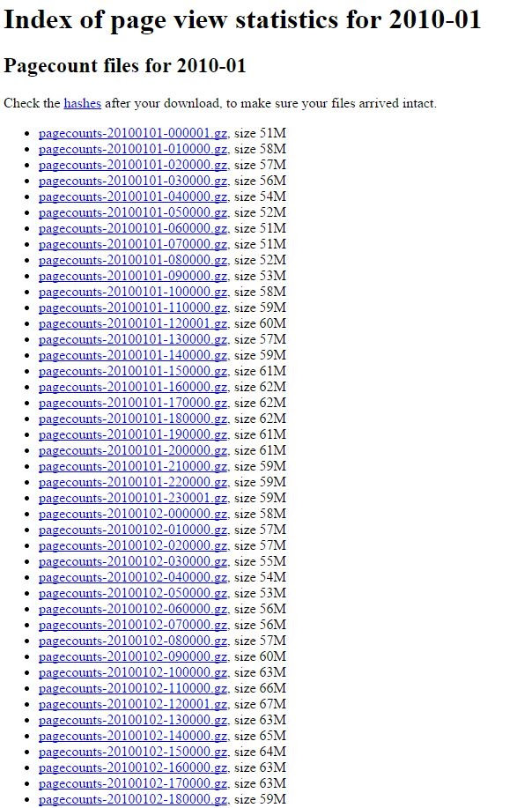
Data Refining
Data obtained from:
https://dumps.wikimedia.org/other/pagecounts-raw/2010/
720 links per month
~60 MB per link

Slide 9
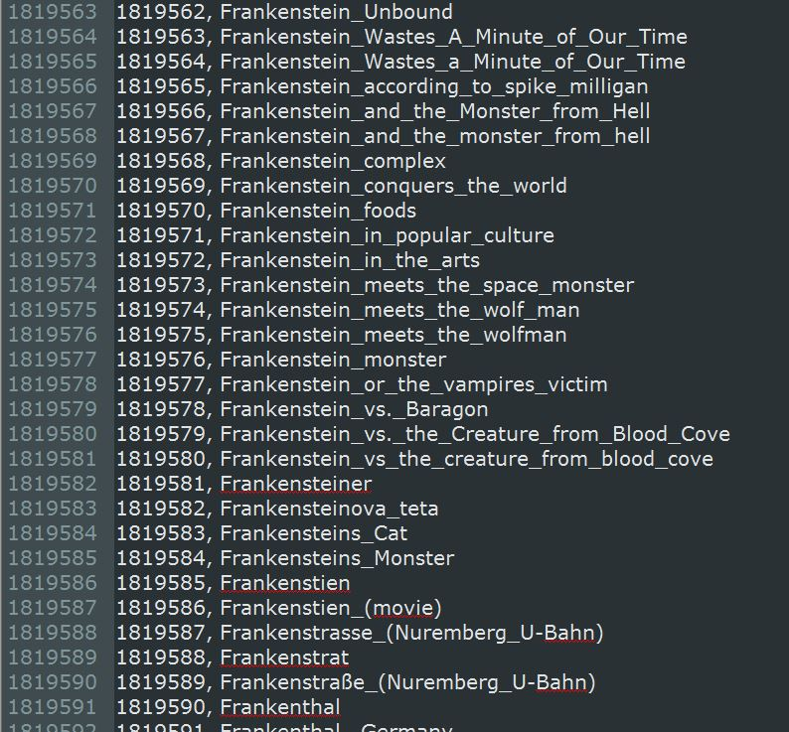
Data Refining
Page Index File (downloaded):

Slide 10
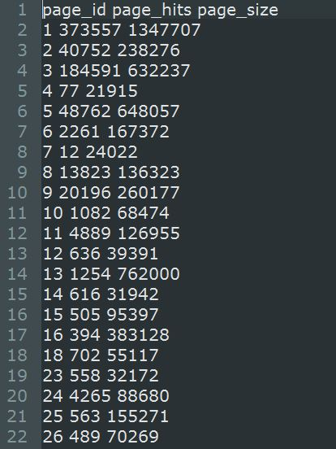
Data Refining
Total Count File (built from raw data):

Slide 11

Data Refining
Links File (~2 GB):
Sample data:
5 4
2 3
1 4
(Link from site index 1 to site index 4)

Slide 12
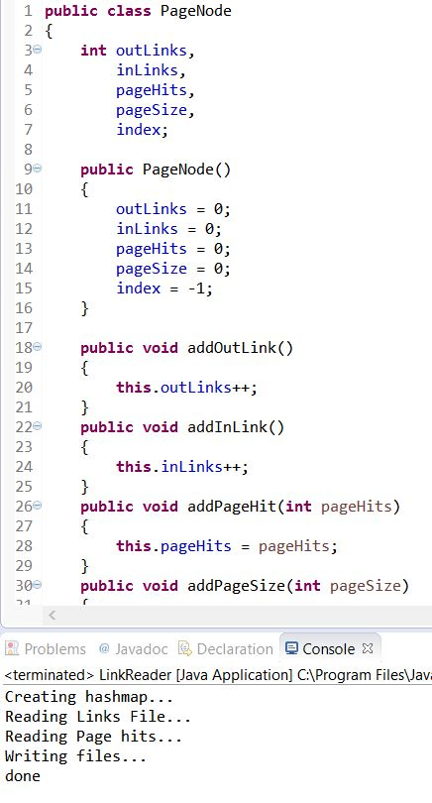
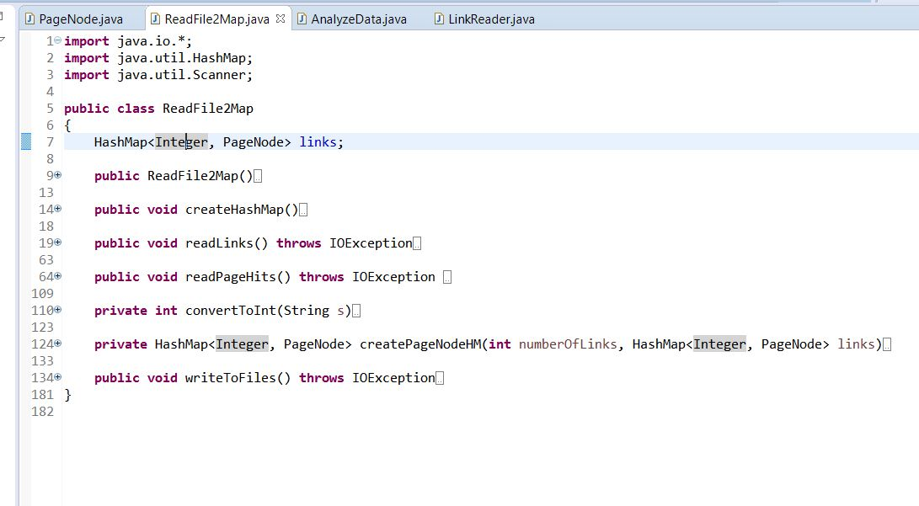
Data Refining
Data Reduction algorithm:

Slide 13
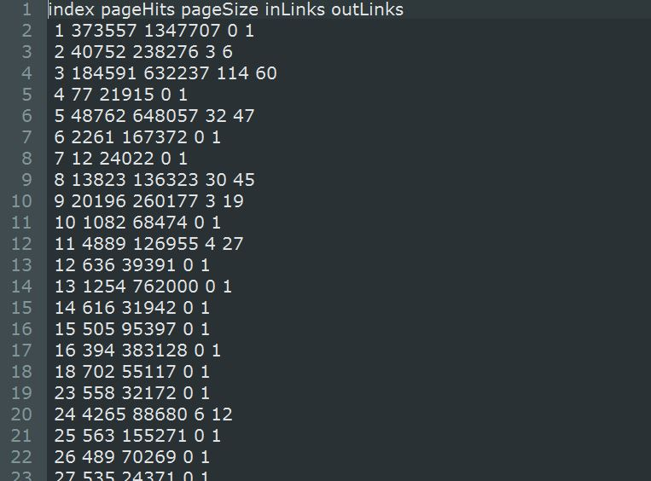
Data Refining
Reduced Data: 2 TB → 150 MB
.015% of data retained

Slide 14
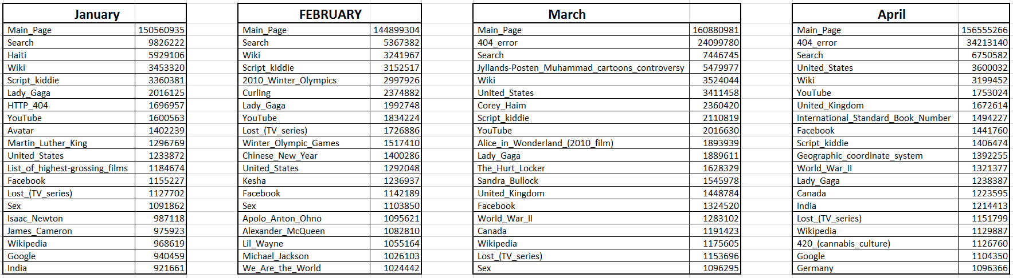
Data
Top 20:

Slide 15
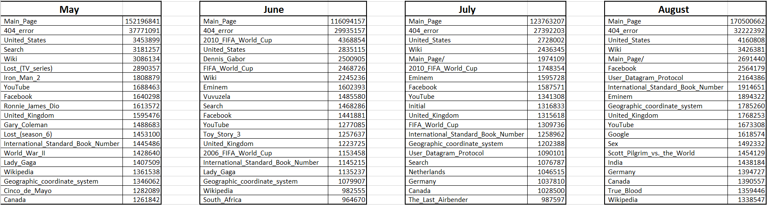
Data
Top 20:

Slide 16
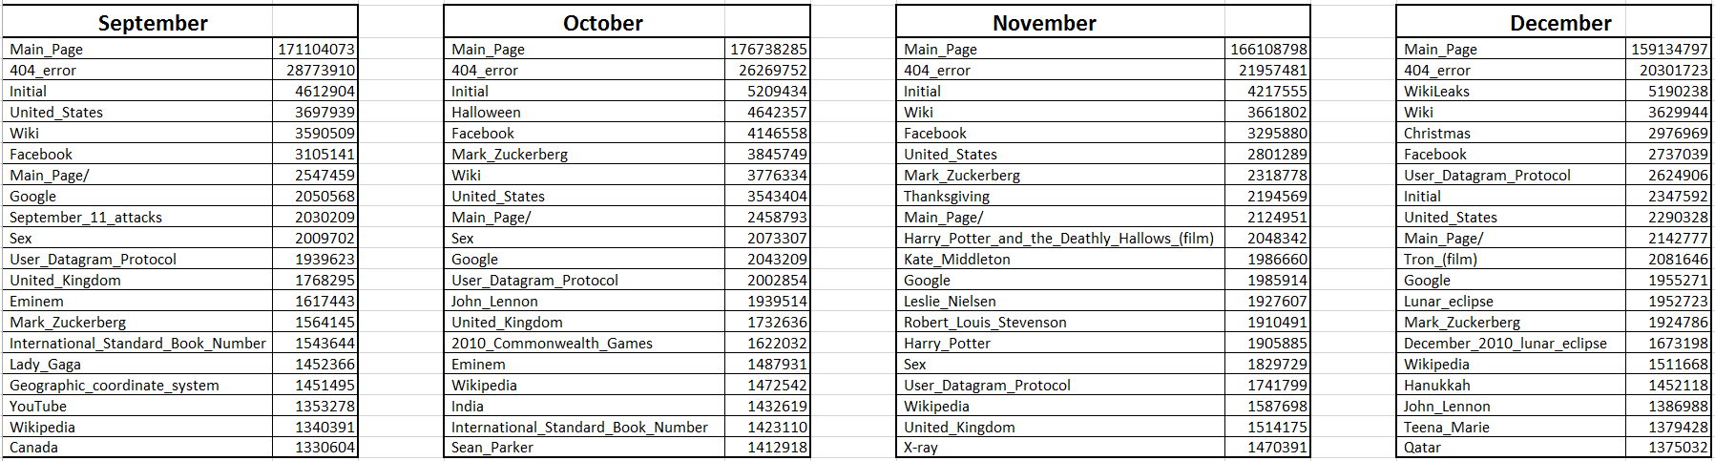
Data
Top 20:

Slide 17
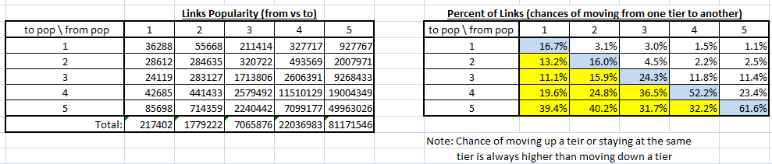
Data Analysis
Split Pages by Popularity
Started with 5 levels (20% of pages per level)
From low popularity(1) to high popularity(5)
For all pages, compared its popularity to the popularity of pages it links to:

Slide 18
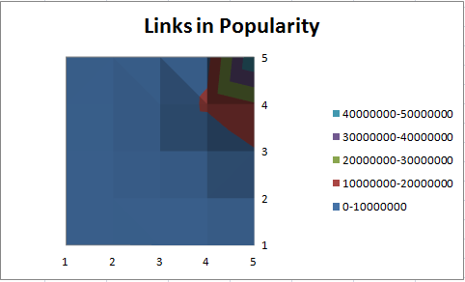
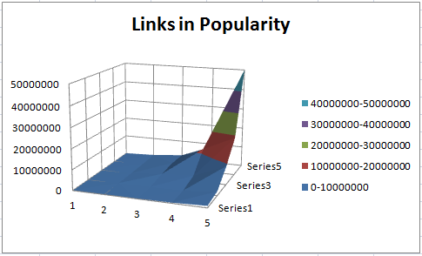
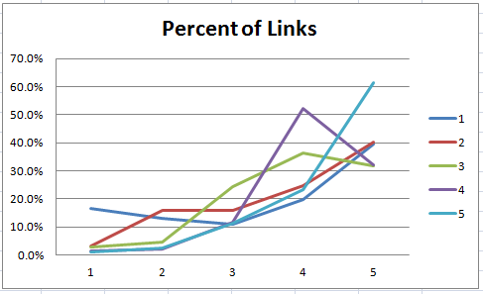
Data Analysis
Graphed:

Slide 19
Data Analysis
Averages:
Compared Average popularity, size, links in, links out
Pages split based on popularity
5 levels (20% of pages per level)
10 levels (10% per level)
30 levels (3.33% per level)
100 levels (1% per level)

Slide 20
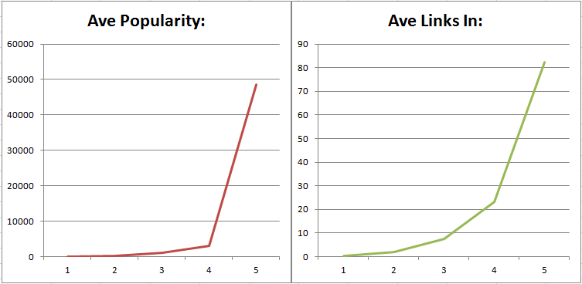
Data Analysis
Popularity vs. Links In (5 levels):

Slide 21
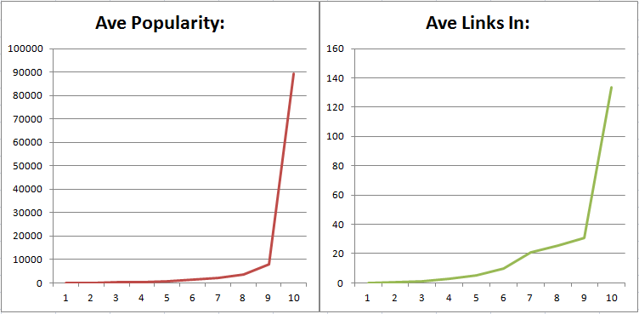
Data Analysis
Popularity vs. Links In (10 levels):

Slide 22
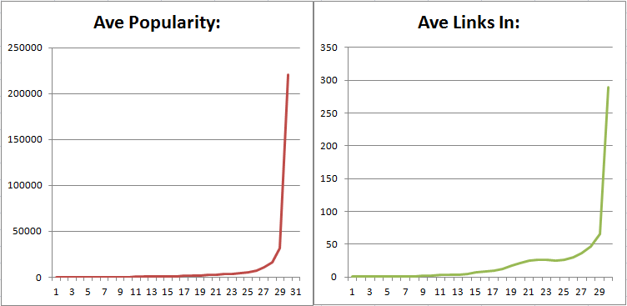
Data Analysis
Popularity vs. Links In (30 levels):

Slide 23
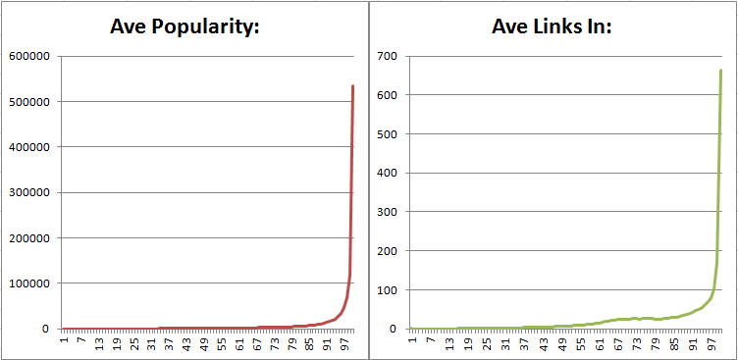
Data Analysis
Popularity vs. Links In (100 levels):

Slide 24
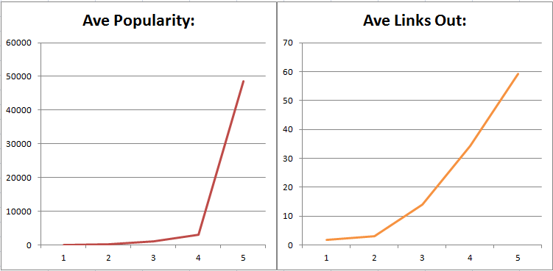
Data Analysis
Popularity vs. Links Out (5 levels):

Slide 25
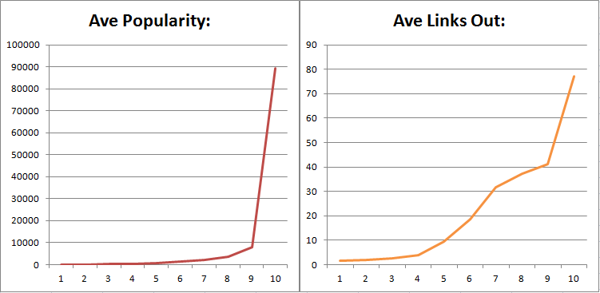
Data Analysis
Popularity vs. Links Out (10 levels):

Slide 26
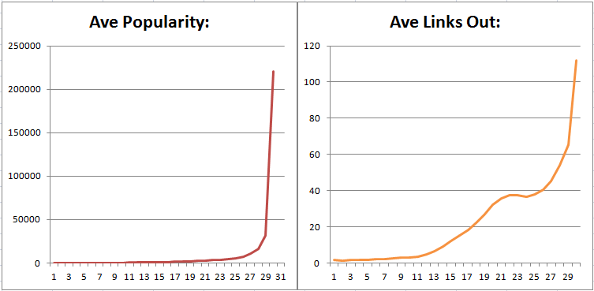
Data Analysis
Popularity vs. Links Out (30 levels):

Slide 27
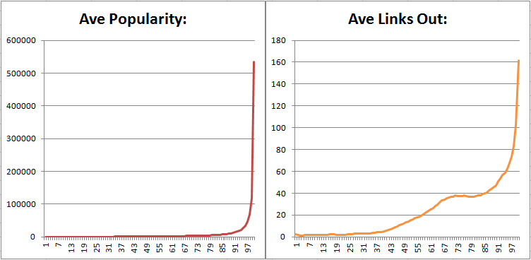
Data Analysis
Popularity vs. Links Out (100 levels):

Slide 28
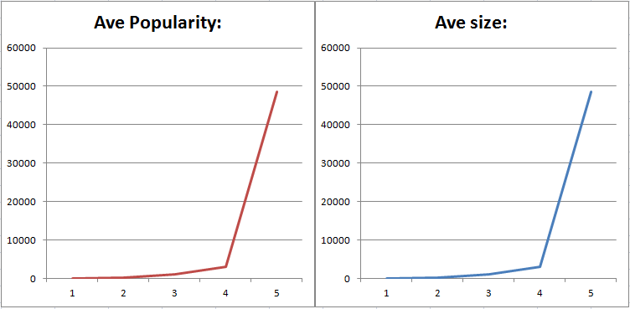
Data Analysis
Popularity vs. Size (5 levels):

Slide 29
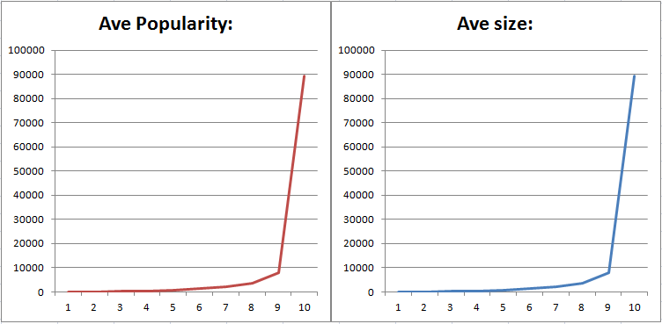
Data Analysis
Popularity vs. Size (10 levels):

Slide 30
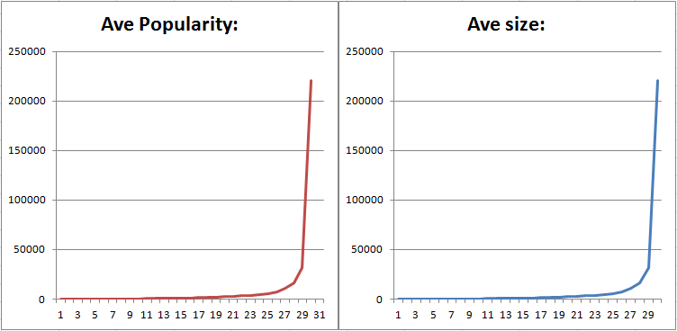
Data Analysis
Popularity vs. Size (30 levels):

Slide 31
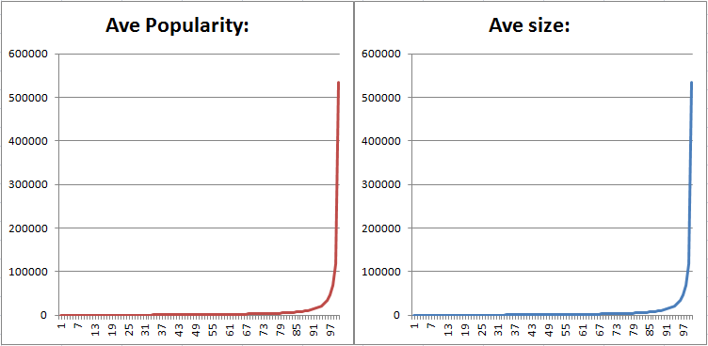
Data Analysis
Popularity vs. Size (100 levels):

Slide 32
Data Outcome
Popularity is directly correlated to:
page size
number of links in
and number of links out

Slide 33

WHY???
Page Links:
Same reasoning behind page ranking: Reliability increases with page links to a page (especially if those pages are Reliable themselves)
Page Sizes:
Pages are maintained/updated by community. The more a page is looked at, the more edits it will have

Slide 34
What does this mean?
Conclusion:
The popularity of a page can be inferred (with fair accuracy) based on its size, links in, or links out.

Slide 35

What’s next
Research Possibilities:
Further analyze these relationships to better guess a pages popularity based on easily obtainable information (e.g. pages size, links in, links out)
Expanding over several years and analyzing changes

Slide 36
Summery
Project Review
Data Evolution
Results
Further Studies

Slide 37
Questions?

